Slide 1
Intermezzo: what to try next?

Slide 2
Rationale
Throw a lot of stuff at you. You decide what you want to explore further.
Objective: Show you what is out there in the field of machine learning. The sky is the limit!
Possible side-effects: You may feel slightly overwhelmed. Just take it one step at a time.

Slide 3

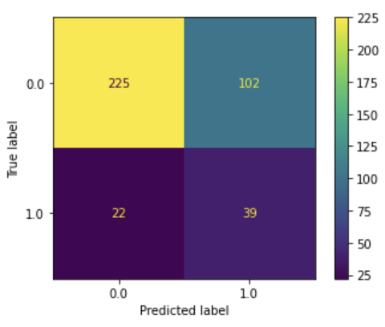
Precision & recall recap?

Slide 4
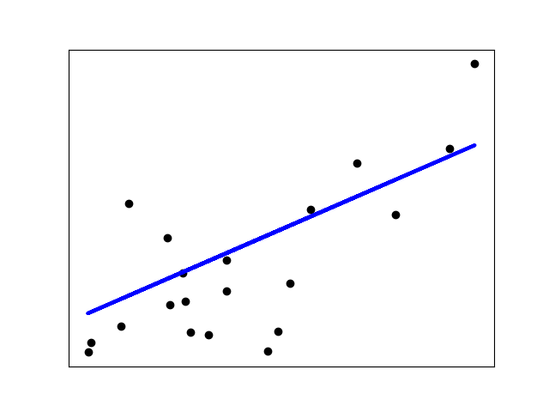
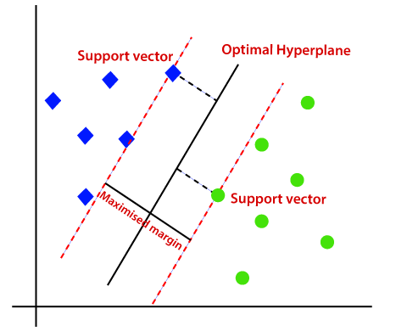
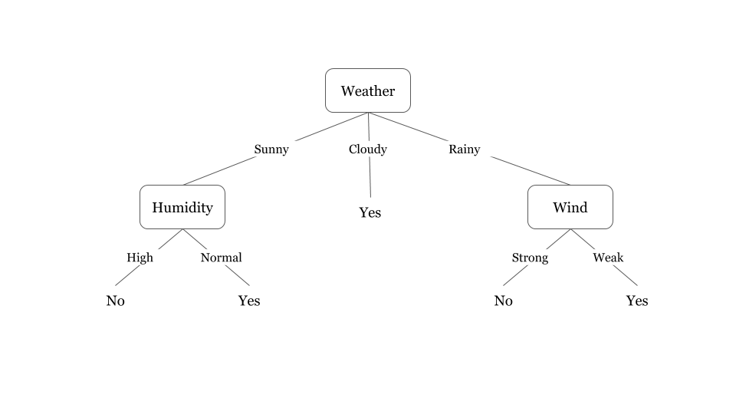
Different models
Linear models (Logistic regression)
Support Vector Machines
Decision trees

Slide 5
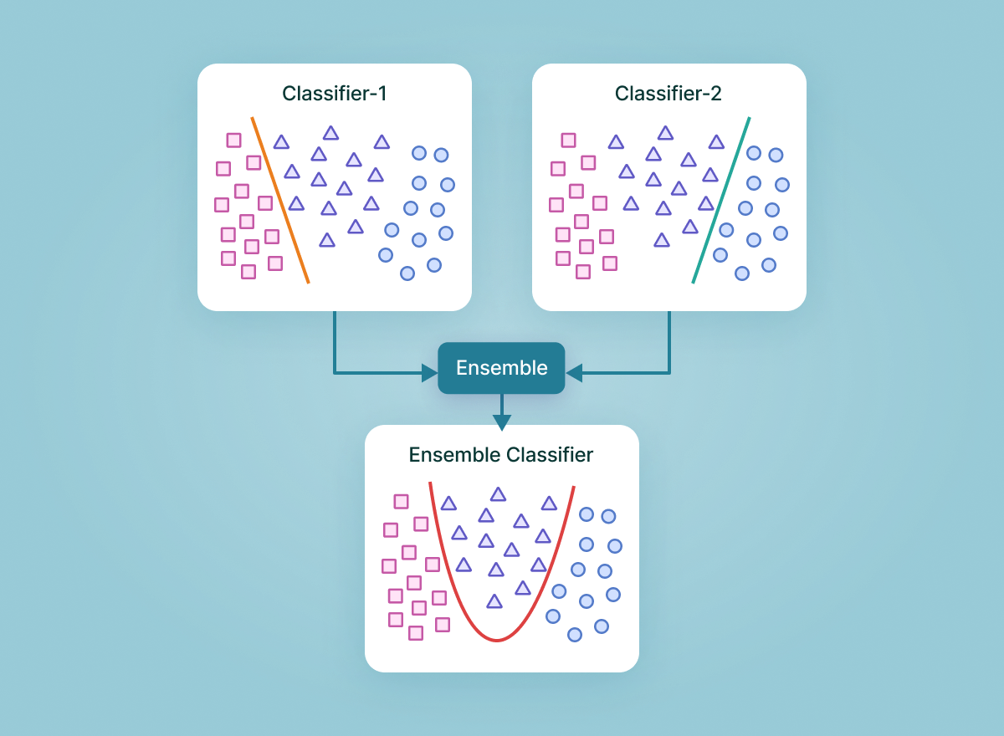
Ensemble learning
>>> from sklearn.ensemble import RandomForestClassifier
>>> clf = RandomForestClassifier(n_estimators=10)
>>> clf = clf.fit(X, Y)

Slide 6
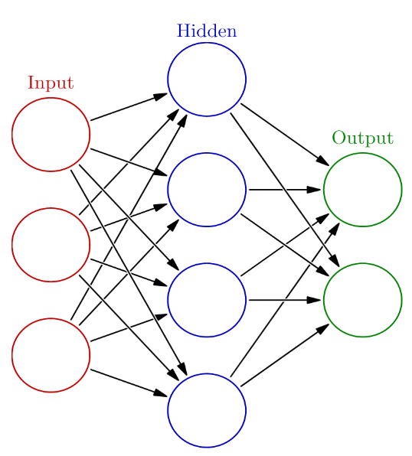
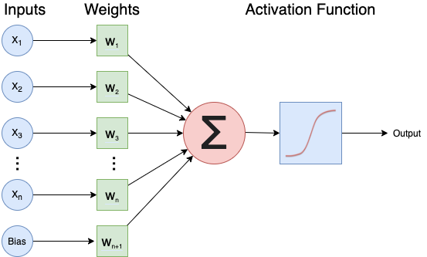
Neural networks

Slide 7
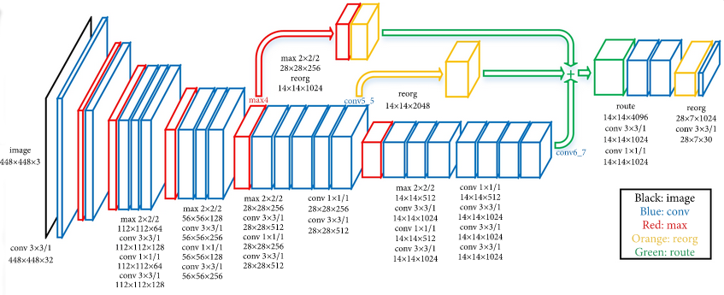
Deep learning
From https://www.kaggle.com/keras/resnet50

Slide 8
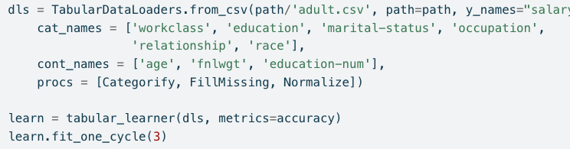
Deep learning with fast.ai

Slide 9
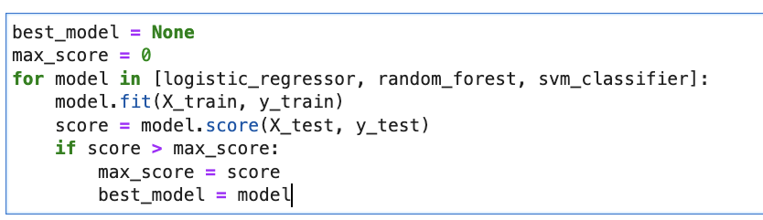
Model sweep
for model in [logistic_regressor,

Slide 10
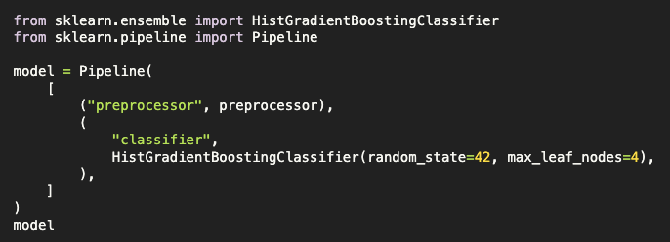
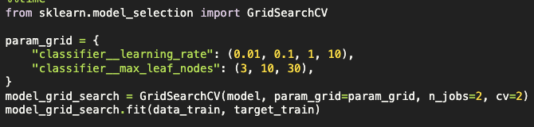
Hyperparameter tuning

Slide 11
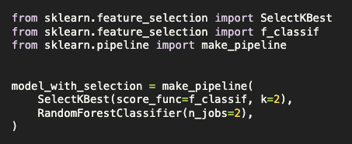
Automated feature selection
Set of all features → Feature selection → Subset of features with highest predictive value → train model

Slide 12
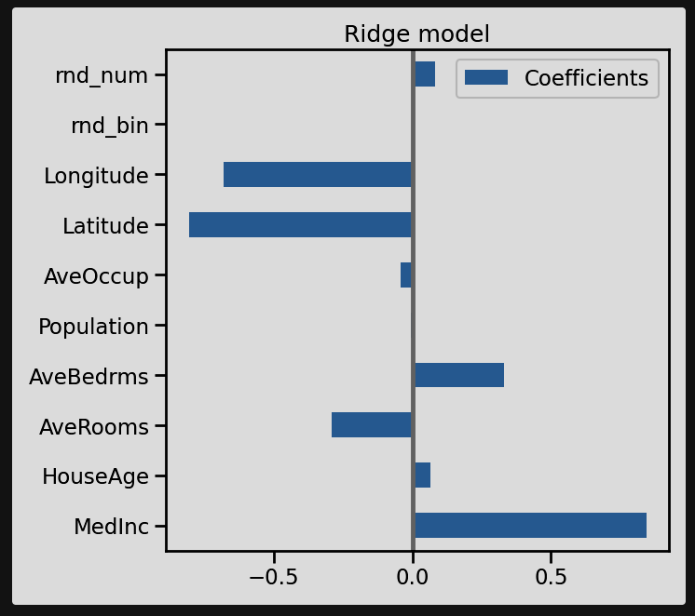
Explainable machine learning: feature importance

Slide 13
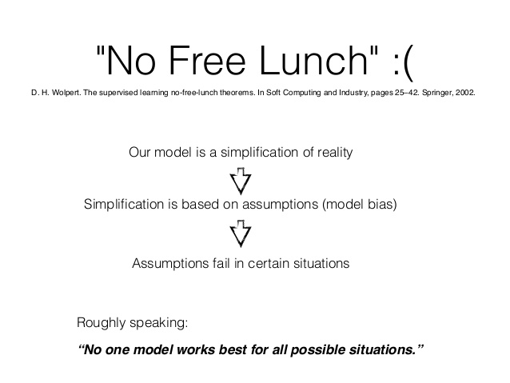

Slide 14

Take it one step at a time
Train model
Evaluate model
Define next steps:
Where does the model still make mistakes?
What are promising next steps?
Focus on: low effort, high impact (low hanging fruits)
Repeat

Slide 15
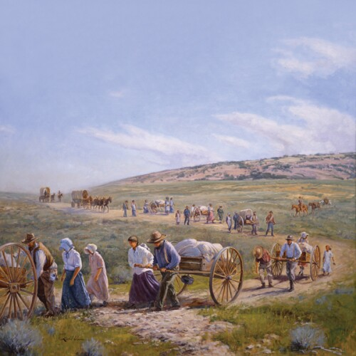
You are pioneers

Slide 16
Resources from intermezzo: what to try next?
More on evaluation metrics: https://inria.github.io/scikit-learn-mooc/evaluation/evaluation_module_intro.html
Different machine learning models:
In general: Scikit-learns amazing user guide: https://scikit-learn.org/stable/user_guide.html
Understanding linear models: https://inria.github.io/scikit-learn-mooc/linear_models/linear_models_module_intro.html
Understanding decision tree models: https://inria.github.io/scikit-learn-mooc/trees/trees_module_intro.html
Understanding ensemble learning: https://inria.github.io/scikit-learn-mooc/ensemble/ensemble_module_intro.html
Support Vector Machines: https://scikit-learn.org/stable/modules/svm.html
Introduction to deep learning course (good for understanding DL and creating your own neural networks with Keras): https://github.com/carpentries-incubator/deep-learning-intro
Fast.ai (Python library similar to sklearn, but applying state-of-the-art deep learning): https://docs.fast.ai/
Hyperparameter tuning: https://inria.github.io/scikit-learn-mooc/tuning/parameter_tuning_module_intro.html
Feature selection: https://inria.github.io/scikit-learn-mooc/feature_selection/feature_selection_module_intro.html
Feature importance: https://inria.github.io/scikit-learn-mooc/python_scripts/dev_features_importance.html

